Slide 1
Small but perfectly formed... connected Microcontrollers
— CO-ND-BU
COM3505, Lecture 3
Prof Hamish Cunningham

Slide 2
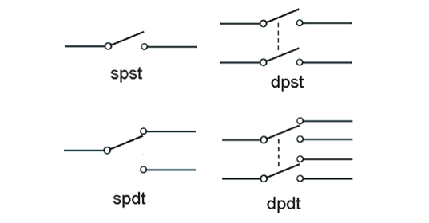
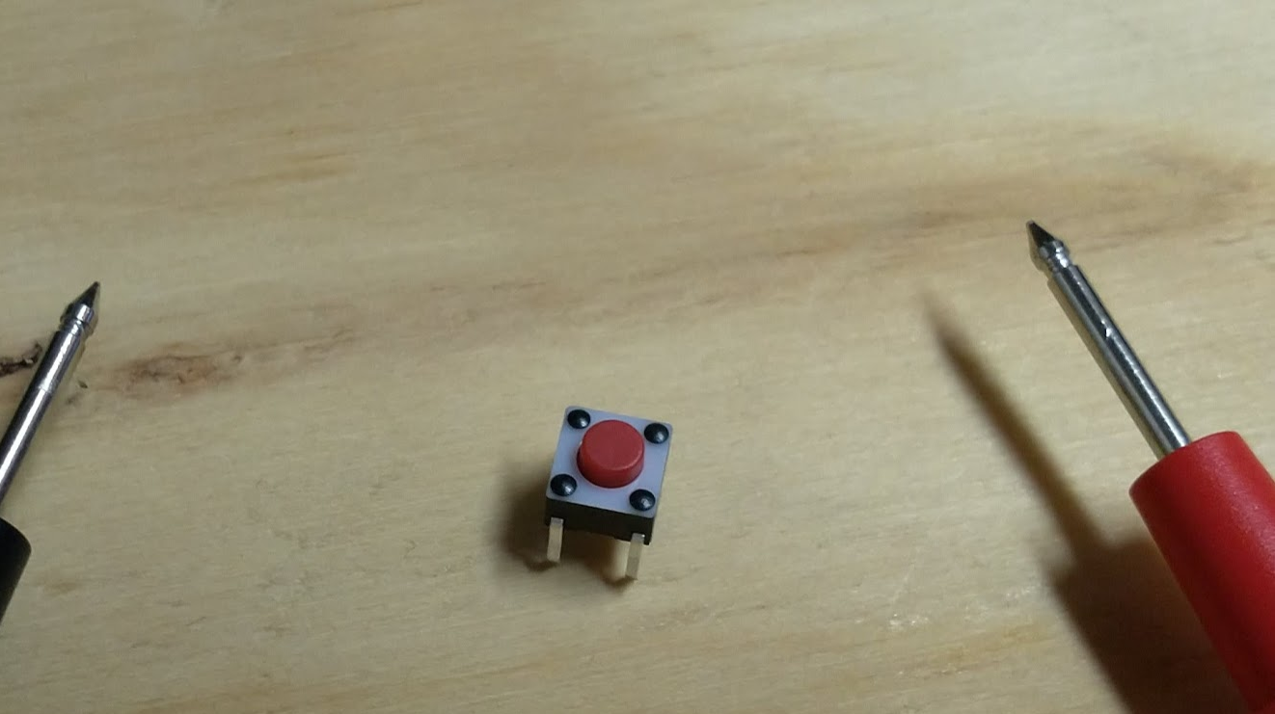
Hands up if… You’re wearing shoes.
You haven’t flashed the EP32 yet.
How do you connect an LED to a microcontroller so you can blink it?
Connect the long pin (anode) to a GPIO pin and run a resistor to ground from the short pin (cathode).
What’s the resistor for?
Limit current through the LED to prolong its life (and control brightness).
How do you toggle a GPIO pin?
uint8_t MY_LED = 14; setup: pinMode(MY_LED, OUTPUT); loop: digitalWrite(MY_LED, HIGH); … digitalWrite(MY_LED, LOW);
How do you get user input using the kit we’ve given you so far?
Read from the switch. Gotchas:
it is an “SPST push-to-make non-latching” so you need the right corners, and you need to read at the same time as it is pressed

Slide 3
When you’ve finished the tunnel…
…and you escape from UniShef PLC, you may get a job in computing tech (or you may wake up and decide to be a nurse or a brainsurgeon or a gardner instead)
if you’re in tech, your role may sit at a layer where installation and system integration issues and the like are solved by someone else: you may turn up and be told “use tool X to do job Y, that’s the way we do it here”
alternatively, you might have to figure out, given objective Z, which tool is best for getting you in the right general direction
this course is more like the latter: things break, we fix them, they break again, we cobble something together and… get the job done by hook or by crook
therefore: …

Slide 4
You might have noticed: we’re NOT teaching you C[++]...
Huh?! You’re all already programmers: you no longer need to study every bracket and comma of the syntax of new languages. You’re nearly professionals: so you need to get ready to beg, borrow and steal (i.e. google it, copy it, share your improvements) your next bit of code inspiration.
And: code “completion” is likely going to be one of the major applications of GPTs — cf. GitHub Copilot, based on OpenAI’s Codex GPT (what ChatGPT uses for code-related questions)
Quick! Learn C! Some resources to help:
www.learn-c.org; www.tutorialspoint.com/cprogramming; www.tutorialspoint.com/cplusplus; www.learncpp.com
On GNU Linux or Ubuntu:
gcc.gnu.org/onlinedocs/;
askubuntu.com/questions/36520/how-could-i-begin-c-programming-on-ubuntu
Finally, rely on the libraries, example sketches, and the set of solutions we distribute via the git repositories.
We’re teaching you to solve problems and develop solutions in a new environment.
Aka: have fun hacking!

Slide 5
News from the lab
now that everyone is running their own machine…
wifi is slow :(
you can do stuff elsewhere and elsewhen :)
use the lab time to figure out what and how, and get help when you need it, then experiment more outside of the lab
if you’re running the docker image, I’ve now pushed an updated version that includes latest core (2.0.14); to refresh your copy:
docker pull hamishcunningham/iot:magic (but be prepared for the ~10GB download)
optimising recompiles: see demo
if you haven’t got welcome.txt in your repo, please come see me in the lab tomorrow
(and if you haven’t got a .gitignore, please fix it!)
to git or not to git…? (contributing to existing projects)

Slide 6
Demo: Skynet’s little sister | docker builds
…

Slide 7
Lecture 3
Contents
review of model solutions for last week
the IoT hardware space: MCUs on devices and ARM on gateways
Maker Tech and the implications of digital fabrication
coding for the IoT: languages for layers; (yet) more on the Arduino (maybe)
meet Andreas, Mr. ESP

Slide 8
Exercises 1 & 2
Using the breadboard, code and test the following:
Ex01: blink the built-in LED; print the device MAC address on the serial line (and monitor it in the IDE)
Ex02: blink the external LED; read from the switch

Slide 9
Model code runner: Thing.ino
// Thing.ino -- COM3505 lab exercise runner sketch
#include "Ex01.h"
...
#include "Ex20.h"
int LABNUM = 4; // which lab exercise number are we doing?
// initialisation entry point
void setup() {
switch(LABNUM) {
case 1: setup01(); break;
...
case 20: setup20(); break;
default: Serial.println("oops! invalid lab number");
}
}
// task loop entry point
void loop() {
switch(LABNUM) {
case 1: loop01(); break;
...
case 20: loop20(); break;
default: Serial.println("oops! invalid lab number");
}
}

Slide 10
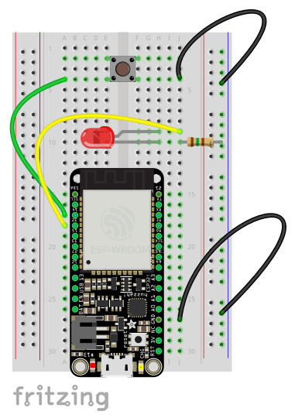
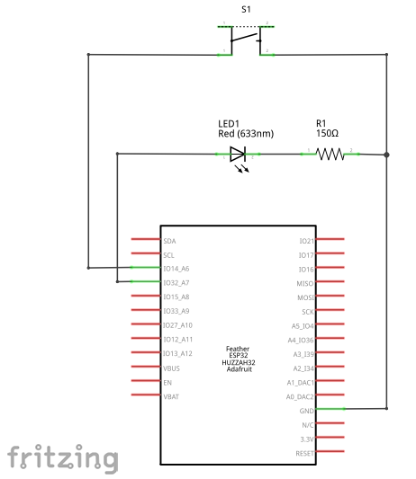
Exercises 1—2
Based on a new circuit that adds an external LED and switch to your ESP (build instructions are in Notes/Ex02Notes/README.mkd in your repo):

Slide 11
[ESP32 Firmware, the Story so Far (1) — last week]
// Ex01.h
#ifndef LAB_01_H #define LAB_01_H
// MAC address /////////////////////////////////////////////////////////////// char MAC_ADDRESS[13]; // 12 char MAC, + NULL terminator void getMAC(char *);
// LED utilities ///////////////////////////////////////////////////////////// void ledOn(); void ledOff(); void blink(int = 1, int = 300);
#endif
// Ex01.ino: printing on the serial line; blinking the built-in LED void setup01() { Serial.begin(115200); // initialise the serial line getMAC(MAC_ADDRESS); // store the MAC address as chip ID pinMode(BUILTIN_LED, OUTPUT); // set up pin for built-in LED Serial.println("\nsetup01..."); // say hi }
// ...Ex01.ino… void loop01() { Serial.printf("ESP32 MAC = %s\n", MAC_ADDRESS); // print the ESP's "ID" blink(3); // blink the on-board LED... delay(1000); // ...and pause } // why not have getMAC return a String? we could, but see: // https://hackingmajenkoblog.wordpress.com/2016/02/04/the-evils-of-arduino-strings/ // https://www.youtube.com/watch?v=eVGvPsCrQ_Y void getMAC(char *buf) { // the MAC is 6 bytes, so needs careful conversion... uint64_t mac = ESP.getEfuseMac(); // ...to string (high 2, low 4): sprintf(buf, "%04X%08X", (uint16_t) (mac >> 32), (uint32_t) mac); } // That DOESN’T MEAN never use String! Just be aware of potential problems.
void ledOn() { digitalWrite(BUILTIN_LED, HIGH); } void ledOff() { digitalWrite(BUILTIN_LED, LOW); } void blink(int times, int pause) { ledOff(); for(int i=0; i<times; i++) { ledOn(); delay(pause); ledOff(); delay(pause); } }

Slide 12
ESP32 Firmware, the Story so Far (2)
void loop02() { if(digitalRead(14) == LOW) { // switch pressed Serial.printf("switch is pressed...\n"); useInternalLED = ! useInternalLED; } if(useInternalLED) { Serial.printf("blinking internal LED...\n"); blink(1, 500); // where did this come from? Ex01.h } else { Serial.printf("setting 32 HIGH...\n"); digitalWrite(32, HIGH); // on... delay(500); Serial.printf("setting 32 LOW...\n"); digitalWrite(32, LOW); // off... delay(500); } }
// Ex02.h #ifndef LAB_02_H #define LAB_02_H bool useInternalLED = true; // which LED to blink #endif
// Ex02.ino // blinking an external LED; reading from a switch
void setup02() { setup01(); // include previous setup for serial, and for the internal LED Serial.printf("\nsetup02...\nESP32 MAC = %s\n", MAC_ADDRESS); // ESP's "ID"
// set up GPIO pin for an external LED pinMode(32, OUTPUT); // set up pin 32 as a digital output
// set up GPIO pin for a switch pinMode(14, INPUT_PULLUP); // pin 14: digital in, built-in pullup }
(but: what happens if you press the switch during a delay…? alternatives?)

Slide 13
Lecture 3
Contents
review of model solutions for last week
the IoT hardware space: MCUs on devices and ARM on gateways
Maker Tech and the implications of digital fabrication
coding for the IoT: languages for layers; (yet) more on the Arduino (maybe)
meet Andreas, Mr. ESP

Slide 14
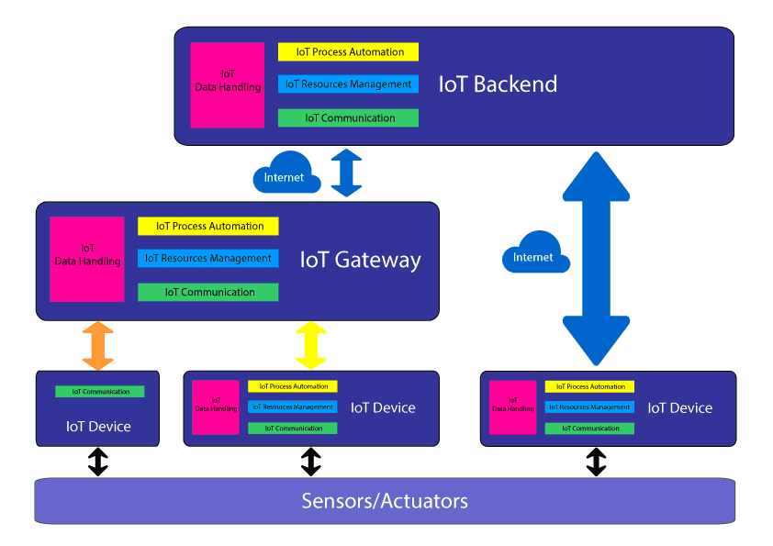
Software Architecture and the IoT (“fog”?!)
Aside from the devices themselves (connected microcontrollers running sensor/actuator rigs), IoT systems will typically also involve one or more of:
a platform, or backend (e.g. IFTTT, AWS IoT, IBM Watson or Adafruit.io)
a gateway (e.g. Google Home, Phillips Hue Bridge, Amazon Echo, Siemens Mindsphere MindConnect, a Pi...)
communications protocols (e.g. TTN, MQTT, COAP, HTTP, SSL/TLS...)
big data processing (Hadoop, Storm, Samza, Spark, Flink…) & analytics
(forklog.net)
Notes:
we could be teaching you the corporate view of the IoT… AWS, IBM, Siemens, ...COM3505: build stuff, corporation-agnostic …. ASR, “Bonsley”

Slide 15
IoT devices mostly use a WiFi or radio MCU
Constraints of power and cost mean the IoT is in the MCU territory.
Speed of development and ease of use mean the easiest option at present is WiFi (or sometimes Bluetooth or LoRaWAN).
Until recently devices would frequently use both an MCU (e.g. Atmel) and a separate WiFi chip (e.g. Mediatek).
The ESP8266 innovated in combining the two in a powerful but cheap package.
The ESP32 adds extra goodies inc. another core, BLE, more I/O.
But if you’ve got power and a higher budget…?

Slide 16
What do the gateways use?
Google Home: “basically an overgrown Chromecast”: Atmel ATSAMD21 32-bit ARM Cortex-M0+
Amazon ECHO: DM3730 Digital Media Processors ARM Cortex-A8
Samsung Smart Hub: Qualcomm IPQ4019 SoC, 4x ARM Cortex A7 (or A9?)
Phillips Hue Bridge: Atmel (Microchip) ATSAMR21E18A SoC ARM Cortex-M0+ (32-bit) MCU
Google Nest Hub 2nd Gen (2021): ARM Cortex-A55 (64-bit, 2GHz quad core CPU)
So: if you’re not constrained by power or cost, then a single-board computer (SBC) like the Raspberry Pi makes sense. (Or: “to ARM or not to ARM”?!)
If you’ve really serious processing to do, then your IoT device will pass its data to the cloud and crunch it there (via a gateway or directly).
COM3505: developing with the ESP32S3 and connecting to the net (first half); applications (second half); some cloud-side on the way. (No gws!)

Slide 17
ESP32[S3] vs. other MCUs
cheap! (£2/unit for the chip, £4/unit for a bare module, £20 for a posh dev board), cheaper ESP8266 still available; ESP family growing
good compromise on power vs. cost
flexible: doesn’t tie you into a proprietary vision of the IoT (or anything else!)
WiFi, Bluetooth Low Energy: ubiquitous and easy (though not IoT specific: WiFi is power hungry for example)
open source SDK and Arduino core on GitHub; closed hardware
layers on top of Arduino APIs and therefore a very large codebase of sensor / actuator libraries
vibrant and extensive contributor community (see GitHub issues and commits, ESP8266 and ESP32 forums, Hackaday projects, Kickstarters…)

Slide 18
Tensilica Xtensa vs. ARM, RISC V, x86...
Xtensa: generate everything from server CPU to tiny MCU from one core definition
Xtensa is current main core in ESP32S3
ULP co-processor is RISC V
you’ll see compilers for both in the toolchain binaries
customisable ISA (instruction set architecture)
this means less optimisation but more generality, potentially lower cost, better support for ASICs (application-specific integrated circuits)
ARM: dominant architecture by volume
MIPS: original RISC, less significant
RISC V: open instruction set computing https://riscv.org/ — future traction: ESP32-C3 (!), -P4, …: the future of ESP chips
what about Intel?!

Slide 19
Intel IoT: ahem
what about Intel?! seems to have given up chasing the MCU market...
ATOM-based: Quark, Joule, Edison: discontinued, summer 2017!
I wrote this 2018: “still available, the Curie… x86 ISA!”
Arduino 101: based on the Curie; but note Adafruit’s comment: “101 is very new, & uses a completely new core chipset! Many libraries won't work with it”...
Cancelled!
‘unlikely Intel could compete at the low end of the “things” market with the ARM camp, and especially with the likes of Qualcomm, MediaTek and others that can leverage their strengths and scale in mobile phone SoC designs into IoT’ [Computer World: https://goo.gl/kLfVEM]
Wired 2014: getting it wrong? https://goo.gl/Smxx3K
2023: Intel selling older CPUs (Celeron, Pentium) as IoT chips
so: ARM vs. the rest? (2024: Intel, AMD, …: chasing NVidia!)

Slide 20
A WiFi MCU for 2024…?
Who knows!
ESP SoCs are not the only game in town. Arduino LLC’s MKR1000 board uses an Atmel ATSAMW25H18 for WiFi. Pine64, known for its Pine-A64 Linux hacker board, recently jumped in with PADI IoT Stamp COM based on Realtek’s RTL8710AF, a WiFi-enabled ESP8266 competitor that runs FreeRTOS on a Cortex-M3. Like ESP-based modules, the PADI IoT Stamp is tiny (24x16mm), power efficient, and dirt cheap, selling for only $2 at volume.
https://www.linux.com/news/linux-and-open-source-hardware-iot
since 2021 the Raspberry Pi 2040 has gained ground: Nordic nRF52833 – 64 MHz 32-bit ARM Cortex-M4 microcontroller, 512 KB flash memory, 128 KB static RAM
Why there’s no top-ten list of IoT processors: http://www.eetimes.com/author.asp?section_id=36&doc_id=1329732 (market fragmentation, mergers and acquisitions, definitional confusion, ...)
Microsoft’s IoT workshop goody bag: ESP32 feather :)
Which is another reason to use the Arduino ecosystem (and to know Arduino C++ and the Arduino IDE…)

Slide 21
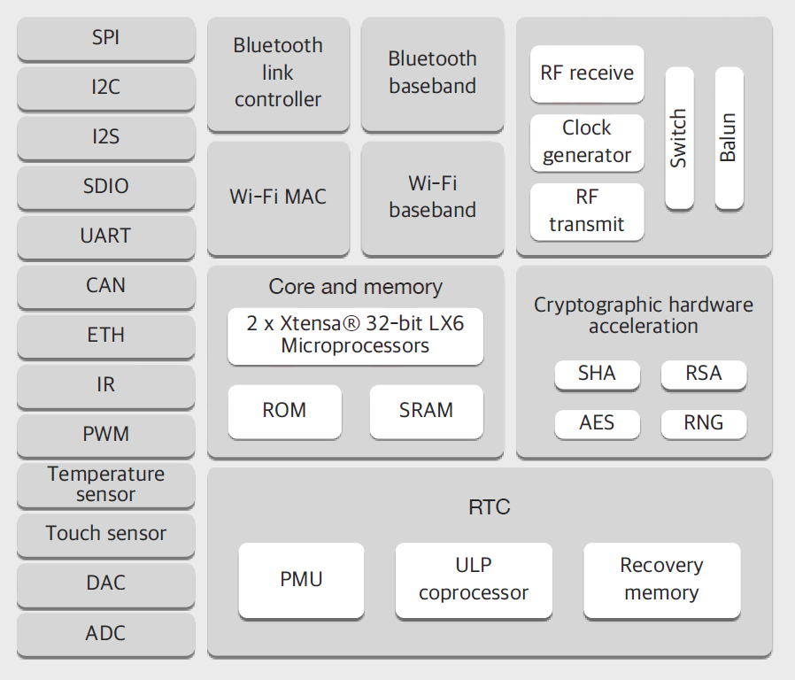
ESP32: Main Elements (1: core)
240 MHz dual core Tensilica LX6 microcontroller with 600 DMIPS
integrated 520 KB SRAM
integrated 802.11 b/g/n Wi-Fi transceiver, baseband, stack and LWIP
Bluetooth (classic and BLE)
up to 16 MB memory-mapped flash
2.3V to 3.6V operating voltage
-40°C to +125°C operating temperature
on-board PCB antenna / IPEX connector for external antenna

Slide 22
ESP32: Main Elements (2: GPIO)
34 GPIO pins assignable to:
Analog-to-Digital Converter (ADC)
Digital-to-Analog Converter (DAC)
Pulse-Width Modulation (PWM) – dimming LEDs or running motors
Touch Sensor – ten capacitive sensing pins
UARTs
I2C, SPI, I2S – two I2C and three SPI interfaces to hook up all sorts of sensors and peripherals, plus two I2S sound interfaces
(more details of these in L5)

Slide 23
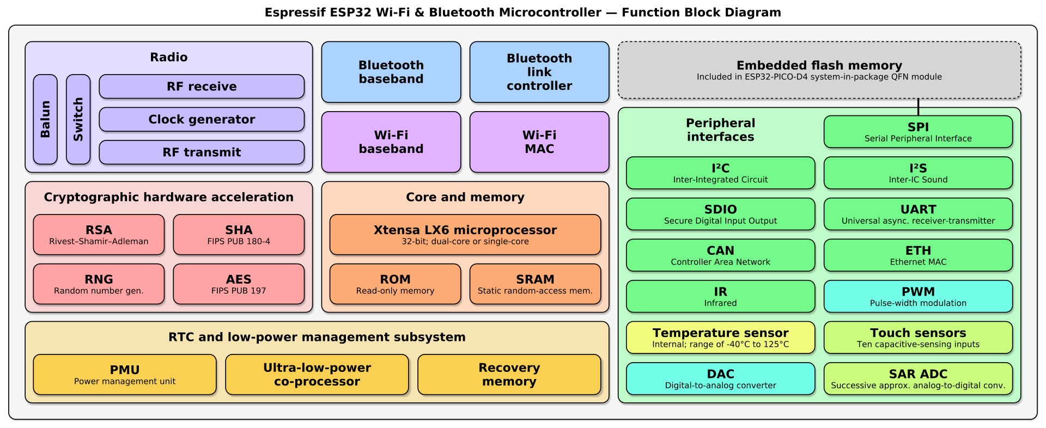
Functional view

Slide 24
Lecture 3
Contents
review of model solutions for last week
the IoT hardware space: MCUs on devices and ARM on gateways
Maker Tech and the implications of digital fabrication
coding for the IoT: languages for layers; (yet) more on the Arduino (maybe)
meet Andreas, Mr. ESP

Slide 25
Manufacturing is changing, don’t get left behind!
Remember when publishing meant dealing with cantankerous editors and the printed page?
Information sharing has been transformed — and now the same tech is moving from the digital to the physical
Digital fabrication: on-line models driving manufacturing processes
Laser cutters, CNC routers, 3D printers, printable circuitry… more and more of our needs can be shared, modified and manipulated in the digital realm
The potential is vast (there’s =~ an 80%-20% ratio between economic activity in the physical and the virtual realms respectively)
Maker Tech: digital fabrication for small teams

Slide 26
[Terms: Maker Technology and Making]
Maker Technology is shorthand for the new wave of fabrication machines that work off digital design models (especially 3D printers, laser cutters and CNC routers). The maker culture that has arisen around the technology mixes in a smorgasbord of other manufacturing innovations ranging from wearable electronics with the Arduino to open computing on the Raspberry Pi, and also pulls in more traditional craft techniques ranging from needlework to furniture making.
In addition notable permeations connect Making to the Internet of Things and to Cloud Computing and Big Data. The projects of Open Source software (and more recently Open Hardware) have been core to the genesis of the culture. Crowdfunding, community interest and social enterprise are also common correlates.
There is widespread recognition that digital fabrication technology and its social expressions herald changes of a similar scale to those that have emerged with the web. For example:
If the last 20 years were about the web, then the next 20 will be about making. Why? Ubiquitous connectivity and decentralised production in the virtual world have made revolutions in creating, sharing and consuming on-line. Now the same changes are starting in the world of manufacturing, and the consequences are likely to be massive.
Indeed the resource devoted to the (re)creation of the physical conditions of human existence is much larger than that devoted to information management (there’s perhaps an 80-20 ratio between economic activity devoted to atoms in comparison to bits). We might therefore expect even more dramatic disruption to our social models in the next period as a result.

Slide 27
Making in Sheffield; democratising manufacture
Democratise... Stuff?!
The net revolutionised the virtual world and made publishing free to all.
But what about the chair your sit on or the fork you eat with?
What if we get the ability to share, modify and build anything, in the same way we can publish anything? What if we can democratise the creation and recreation of the physical world? What if we can devolve manufacturing to individuals and communities?
Perhaps we would make different choices? Perhaps we wouldn't put profit before people? Perhaps we would stop melting the poles...?
Less optimistically, perhaps we’ll have to make everything locally because of protectionist conflict, transport breakdown, economic fragmentation….
“Sheffield has a strong track-record of open access makerspaces, including one of the UK’s first at Access Space (and more recent entrants including Sheffield Hardware Hackers and Makers in Portland Works, Roco on Glossop Road (now closed) or Makers on the Edge on Abbeydale Road, the iForge). These spaces have had a fantastic impact in enabling new educational opportunity and new manufacturing enterprise in the city. For example Pimoroni Ltd., a Sheffield SME that now employs around 30 staff (and has contributed equipment for our work), started with a competition entry to design the logo for the Raspberry Pi and the creation of a case for the Pi board that was prototyped on an Access Space laser cutter. This case still sells in 10s of 000s at prices far above those of the equivalent imported goods, demonstrating the disruptive power of Maker Tech.”

Slide 28
Why is Making relevant here?
The story of how digital fabrication will play out in the world of electronics (and embedded computation & the IoT) is yet to be played out. Opportunity!
There’s a big-and-getting-bigger cross-over between Maker tech and electronic prototyping.
The board we’re using is from a Maker tech company.
Everyone needs to know about this stuff :)

Slide 29
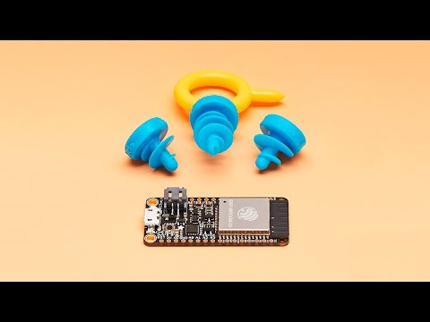
Boards for Makers: Feather & Featherwing
Also on Vimeo: https://vimeo.com/216975153

Slide 30
Lecture 3
Contents
review of model solutions for last week
the IoT hardware space: MCUs on devices and ARM on gateways
Maker Tech and the implications of digital fabrication
coding for the IoT: languages for layers; (yet) more on the Arduino (maybe)
meet Andreas, Mr. ESP

Slide 31
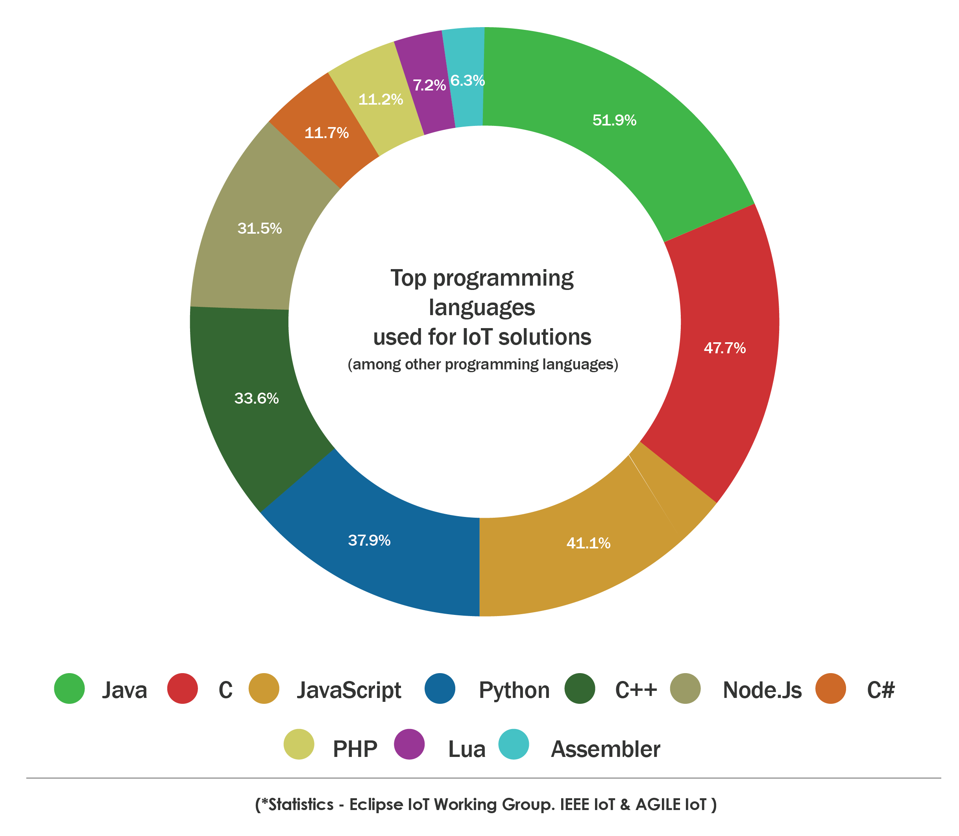
[What else do we need to learn?
Which programming language(s) for IoT? (1)]
According to one survey:
between them C and C++ are used by >80% of IoT programmers (devices only?)
Node.js plus Javascript are also a good bet, used by 70%.
Java: >50%
Python: nearly 40%
COM3505: both C and C++ (as implemented in the Arduino and Xtensa toolchains)

Slide 32
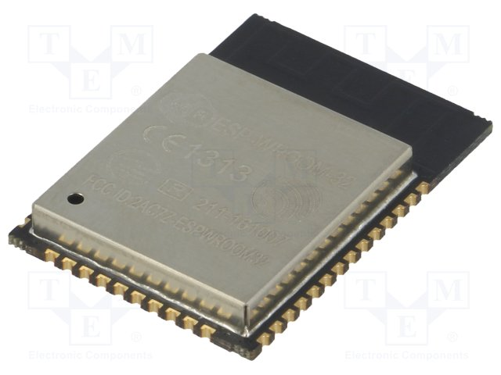
Loading and language
What does Python or Java or Node need that C or C++ doesn’t?
Runtime interpreter (at least of bytecode)
Which means that on IoT devices….?
Additional load; which means…? (Think power, cost, constraints…)

Slide 33
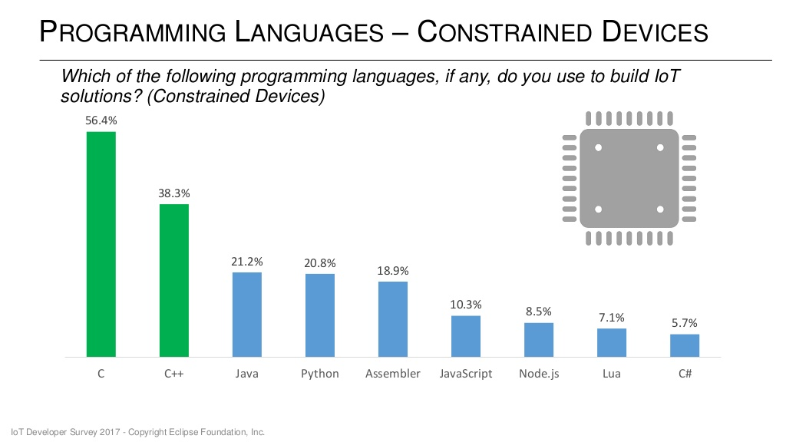
[Which programming language(s)? (2)]

Slide 34
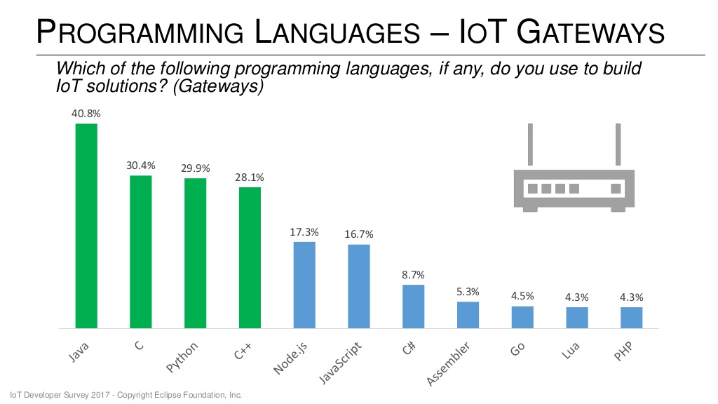
[Which programming language(s)? (3)]

Slide 35
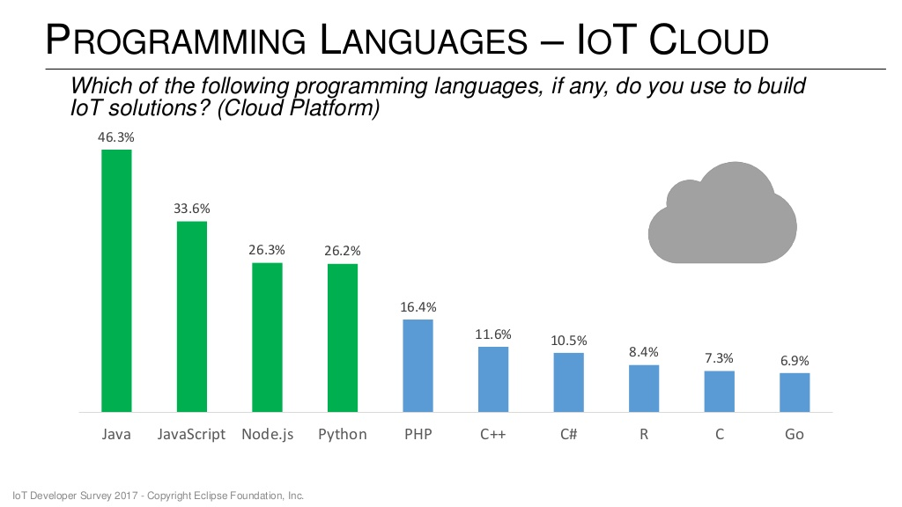
[Which programming language(s)? (4)]

Slide 36
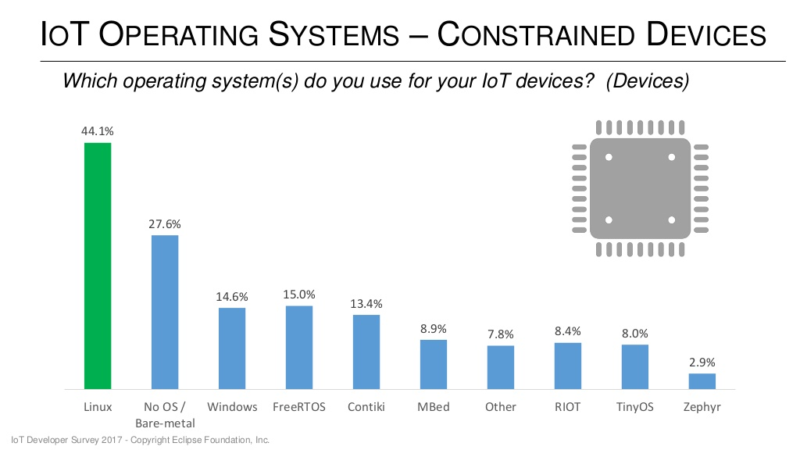
[Which programming language(s)? (5: the OS)]

Slide 37
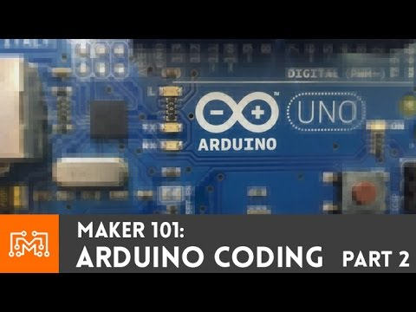
[Enough chat already, let’s code! (1)]
(This example uses an Arduino board, not an ESP.)

Slide 38
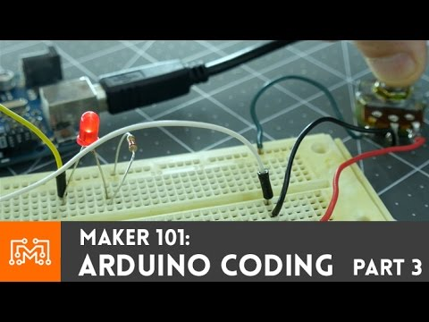
[Enough chat already, let’s code! (2)]
(This example uses an Arduino board, not an ESP.)
Need a slower presenter?! Try: https://youtu.be/d8_xXNcGYgo

Slide 39
Lecture 3
Contents
review of model solutions last week
the IoT hardware space: MCUs on devices and ARM on gateways
Maker Tech and the implications of digital fabrication
coding for the IoT: languages for layers; (yet) more on the Arduino (maybe)
meet Andreas, Mr. ESP

Slide 40
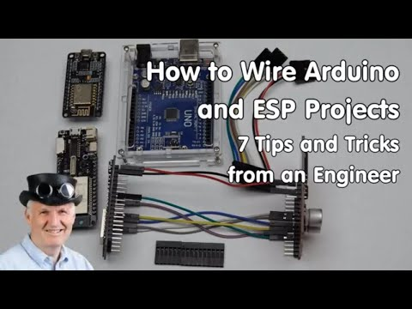
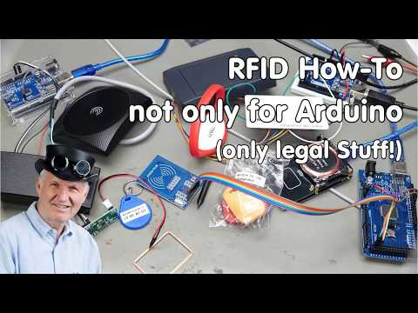
Andreas Spiess, Mr. ESP
ESP camera? try https://youtu.be/5IhhyJjjCxo
YouTube channel: https://goo.gl/LtNx60 (More notables: Neal Kolban; Telecom Informer/2600 Mag; Chris Greening/atomic14)
4.30—6.30: arduino vs. esp pinouts Good to read: Neal Kolban’s pay-as-you-feel book on ESP32

Slide 41
Threads? Processes? Ha!
The ESP is a 2 core device — so in order to perform multiple tasks at once we need to adopt a multiprocessing model of one sort of another.
Core 0 is the “protocol core”, generally only used by internals; core 1 is ours.
A simple model: time slicing in the main loop, using...
a loop counter (e.g. a uint32_t; it will overrun but we don’t care)
a set of iteration points at which different tasks run, e.g.:
if(loopCounter == TICK_MONITOR) { // monitor levels, step valves, push data
and/or a slice size to modulo the loop counter:
if(loopIteration % sliceSize == 0) { // a slice every sliceSize iterations
Exercise 5 (Ex05) is to explore models like this in your MyThing sketch. How many milliseconds does an action take? How does loop code relate to the ESP wifi stack? What other options are there?
Hint: FreeRTOS has a richer model of scheduling, using timers and interrupts.

Slide 42
Your TODO list for week 3:
Read and digest Chapter 3
Coding: (some of) exercises 3—6 (whahey! it’s the Internet of Things! wifi access points, web servers (Ex06))
Build a 9 LED breadboard
Do the reading
Make sure you understood the lecture, and review the slides if needed
Don’t forget to hoover the cat! And chill!

Slide 43
THE END

Slide 44
Old slides follow
(use them at your own risk!)

Slide 45
Open source in practice: S3 boot bug
trouble flashing your new feather? see #troubleshooting-ports; the back story:
2020: voltage glitching fault injection vulnerability found in original ESP32, impossible to fix without silicon changes
in 2021 started to get access to next-gen ESP32 (the S3), prompted partly by the vulnerability and also by move towards RISC V — in the co-processor — and the usual bigger+better cycle
in 2022 we ported the unPhone over to the S3, and decided to supply Adafruit’s S3 feather for this course
by late 2022 I had been working with the chip for what felt like a good length of time; I wasn’t expecting big surprises! there were some differences, and some instability, but it was going well on balance, and I’d run lots of code on S3s from different IDEs
January: I’ll just pop into the lab to check everything is ok on the Uni machines…
EEEEK!!!! why is it so hard to flash!?
cue a lot of research into bootloaders, USB modes, and IDE and OS serial management…

Slide 46
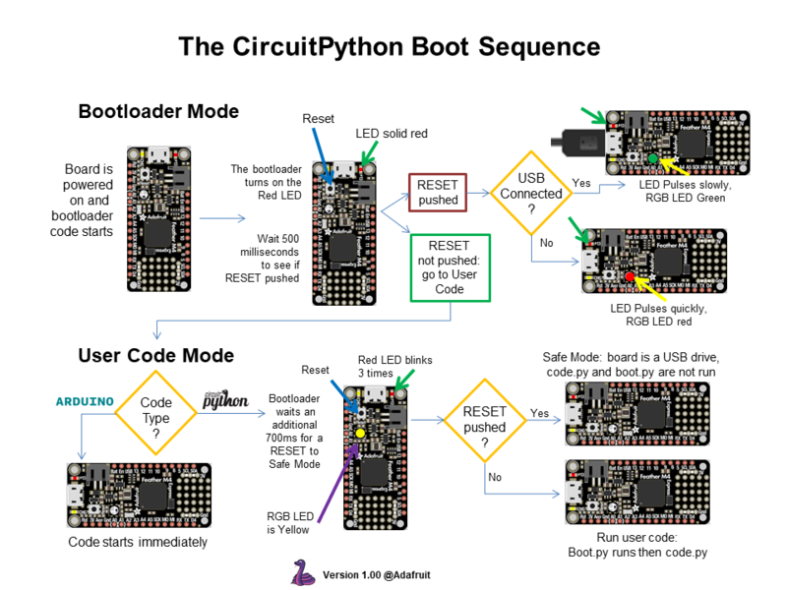
S3 boot bug (2): suspicious bootloaders…
How do you make boards that non-specialists can use? Arduino is the previous generation’s answer.
More modern answers:
visual programming on MicroBit — good for schools but not beyond?
[Circuit|Micro]Python on MCUs — starting to be a contender
Zalan’s answer: do your own Rust port (!)
For the latter it is now common to use a UF2 bootloader, and have the device present as USB mass storage class. Save a .py file and reload the firmware!
Downside: bootloader becomes very complex!

Slide 47
S3 boot bug (3)
prior to the S3 ESP32 boards used an additional chip to manage the serial line (e.g. CP2104 USB to UART Bridge; we’ll talk about the UART protocol week after next)
then USB capability was added natively to the chip
the Adafruit S3 feather (and similar boards) now connect USB directly to the ESP32, which reduces complexity and cost, but it also changes the way the device presents itself to the OS (to support CircuitPython, UF2, and JTAG over USB, for example)
managing this is difficult! IDF release 4.4.3 introduced a HAL USB mode switch bug … and it only presents sometimes and on some platforms!
the upshot is that sometimes it is impossible to flash :( details:
summary 1 and summary 2 of original discussions on Adafruit forums
discussion and pull request of the likely fix
example of how to run that in PlatformIO in the course example code (triggers a big download!); upcoming 2.0.7 core will include the fix
in the Arduino IDE it may do the same to replace the stable boards manager URL in preferences with the development version, and choose the latest
long story short: this type of thing is painful, but does prove the advantages of open source! (and, the bigger the community the faster the fix)

Slide 48
One more question...
Who can tell me what it says in “welcome.txt”?!
<<answers in the chat>>
As of last Friday I have around 60 (out of 90) repos that are successfully pulled down from the cloud (using GitLab’s API called from a Groovy script called from a bash script called from a lot of swearing...); whenever this works you’ll get a welcome.txt added to your repo…
You’re not properly enrolled until that has happened, so please give it a shot this week:
create an account on gitlab.com
create a private project called com3505-student-2021
send your gitlab user ID to hc-p4-3.shef.ac.uk as per the notes
thanks!

Slide 49
Demo
<<breadboarding an LED (Gareth)>>

Slide 50
Breakout groups
get into (different?!) breakout groups for 7.33 minutes and:
introduce each other briefly
choose a rapporteur (someone to report back)
discuss some code you’ve been working on (Ex02 perhaps?)
have the rapporteur paste some of it on the discussion board thread
back together in 7⅓ minutes

Slide 51
(Apropos the IPCC’s watered down 2018 report or 2019 XR) Appropriate tech: less waste!
IoT: small cheap local... Low power!
Less cloud, more microcontrollers!
This is also, in theory, a potential benefit of fog computing (aka edge computing), which implies:
reduced data migration to the cloud
increased reliance on edge device computation
resilience and (partial) autonomy in face of network or cloud outages
Theoretically, IoT will make business more efficient, a claim that is backed up by some early anecdotal evidence. Farmers are more closely monitoring crops with the help of sensor networks to ensure a better yield, and factory owners are monitoring operations to spot maintenance issues without requiring costly shutdowns. Electric utilities have been early IoT users, using sensors to monitor equipment and help customers reduce energy bills. If and when we start taking energy consumption and climate change seriously, IoT will be one of the key tools for documenting the problem and helping to solve it.
https://www.linux.com/news/who-needs-internet-things
Peer-to-peer vs. cloud: liberation from the advertising surveillance industry! :-)

Slide 52
Demo: 9 LEDs via ESP IDF (1)
Prototyping IoT devices has become much easier and cheaper in recent years. This makes development cycles much faster: from idea to prototype to product is now a cycle measured in weeks and months instead of years. We'll finish our quick tour of prototyping skills (that began in Lab 1 with soldering, breadboarding and using the multimeter and signal generator etc.) by building a more (physically) complicated circuit. This week we'll build it on a breadboard, then next week solder it onto matrixboard (which is a typical cycle in early prototyping; the next step would be to design a PCB and start manufacturing test boards).
In the second half of term you'll have the opportunity to build projects that use the unphone's expander board, e.g. to add GPS, or mp3 playing, or motor drivers, or pollution sensors, or ultrasonics, or etc. These also require soldering, and when they don't work first time the multimeter and oscilloscope are our first ports of call to discover why.
(Hate soldering? Don't worry, there are also projects that only use the unphone.)

Slide 53
Demo: 9 LEDs via ESP IDF (2)
in your repos: NineLEDsIDF/, which uses unphone/sdks/esp-idf
IDF:
Espressif IoT Development Framework
native, 80% C (20% C++), highly configurable (see sdkconfig)
advantages (see also https://www.esp32.com/viewtopic.php?t=5669):
everything the chip can do, IDF can do (= more than Arduino)
command-line build (with TextMate or VSCode or vi or Eclipse on top) is easy
solid implementations of e.g. OTA included
disadvantages:
C less easy to read than C++
not portable to other MCUs
much less knowledge out there to google relative to Arduino C++
you’ll still end up needing Arduino libraries for sensors and actuators (works fine in IDF though)

Slide 54
Recap (1): the story so far...
created github repo: pull weekly updates; push code assignments
sent data to the cloud server (com3505.gate.ac.uk)
set up the Arduino IDE and started writing C++ Sketches
coded: inbuilt-LED blink; print MAC on serial, monitor in IDE;
investigated memory fragmentation and the String class
LTSP Linux issues:
/dev/ttyUSB… not writeable
login fails; X window manager doesn’t appear
Apparently one or both are symptoms of a full local home… (Ruby gems? Arduino unpacked to the wrong location?)
Solution: move stuff to u-drive
Next up in the labs: week 3 notes now published connecting and programming external devices; debugging; time slicing

